Slide 1
DATA PROTECTION AND PRIVACY

Slide 2
What is Data Protection?
Data protection is the process of safeguarding important information from corruption, compromise or loss.

Slide 3
Algorithm
Using binary and BCD conversion.
ASCII conversion
Pattern recognition
Indexing

Slide 4
a
097
0000 1001 0111
100000 111001 110111
10 00 00 11 10 01 11 01 11
0 1 2 3 4 5 6 7 8
8 1 4 7 5 2 3 6 0
11 00 10 01 01 00 11 11 10
110 010 010 100 111 110
622476
Encryption Process
(algorithm)

Slide 5
622476
110 010 010 100 111 110
11 00 10 01 01 00 11 11 10
1 4 7 5 2 3 6 0
0 1 2 3 4 5 6 7 8
10 00 00 11 10 01 11 01 11
100000 111001 110111
0000 1001 0111
097
a
Decryption
Process
(algorithm)

Slide 6
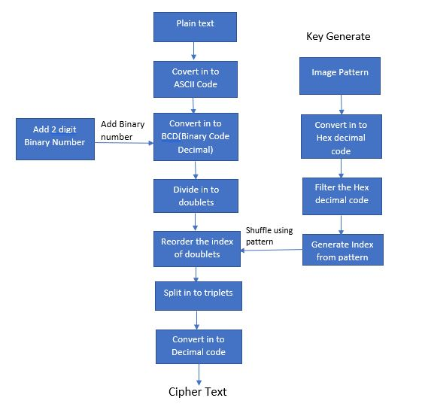
Flow Chart:

Slide 7
Code-622476
(abcdefg-0123456)-assigning random alphabets to the decimal code
gccehg –taking as a string variable.
Predefined words and to make a sentence and encrypt with AES algoritham.

Slide 9
THANK YOU

